Slide 1



PRACTICE WITH PIG
Section -1 GROUP 3

Slide 2



Team Slide
Sneha Ojha
Vijaya Raja Mayuri Akula
Lahari Thamatam

Slide 3
Contents
What is Apache Pig?
Importance of Apache Pig?
Features of Pig
Pig Architecture
Installation, executing, grunt shell.
Pig Datatypes and Pig operators.
Demo
Sneha Ojha

Slide 4
What is Apache Pig?
Apache Pig is a scripting platform to process and analyze larger datasets. Data manipulation operations can be done in Hadoop using Apache Pig.
Pig uses a high level language called Latin Pig.
Apache Pig is an abstraction over MapReduce.
Apache Pig uses Pig Engine to convert Latin Pig script input into MapReduce jobs.
Sneha Ojha

Slide 5
Importance of Apache Pig?
Few great features of Apache Pig are:
Set of operators: join, sort, filer, etc.
Extensibility: the existing operators allows users to develop their own functions to read, process, and write data.
User-defined functions: it provides the facility to create user-defined functions in other programming language such as java and invoke.
It works with both structured as well as unstructured data.
Sneha Ojha

Slide 6

Apache pig vs map-reduce
Apache Pig
MapReduce
Join operation in Apache Pig is pretty simple.
New programmer with basic knowledge of SQL would work conveniently with Apache Pig.
Apache Pig uses multi-query approach which allows reducing the length of codes.
Join operation between dataset is quite difficult
Java is must to work with MapReduce.
MapReduce requires 20 times more number of task line.
Sneha Ojha

Slide 7
Apache pig vs hive
Apache Pig
Hive
Pig Latin was originally created by Yahoo.
Apache Pig can handle structured, unstructured, and semi structured data.
Apache Pig doesn’t support web interface.
HiveQL was originally created by Facebook.
Hive mostly use structured data.
Hive supports web interface.
Sneha Ojha

Slide 8
Features of Pig
Few great features of Apache Pig are:
Set of operators: join, sort, filer, etc.
Extensibility: the existing operators allows users to develop their own functions to read, process, and write data.
User-defined functions: it provides the facility to create user-defined functions in other programming language such as java and invoke.
It works with both structured as well as unstructured data.
Sneha Ojha

Slide 9

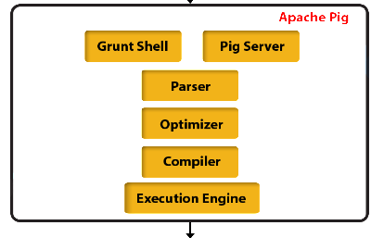

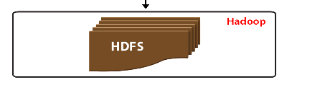
Pig Architecture
Vijaya Raja Mayuri Akula
Notes:
@Refered :https://data-flair.training/blogs/pig-architecture/

Slide 10
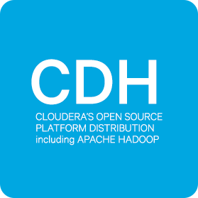
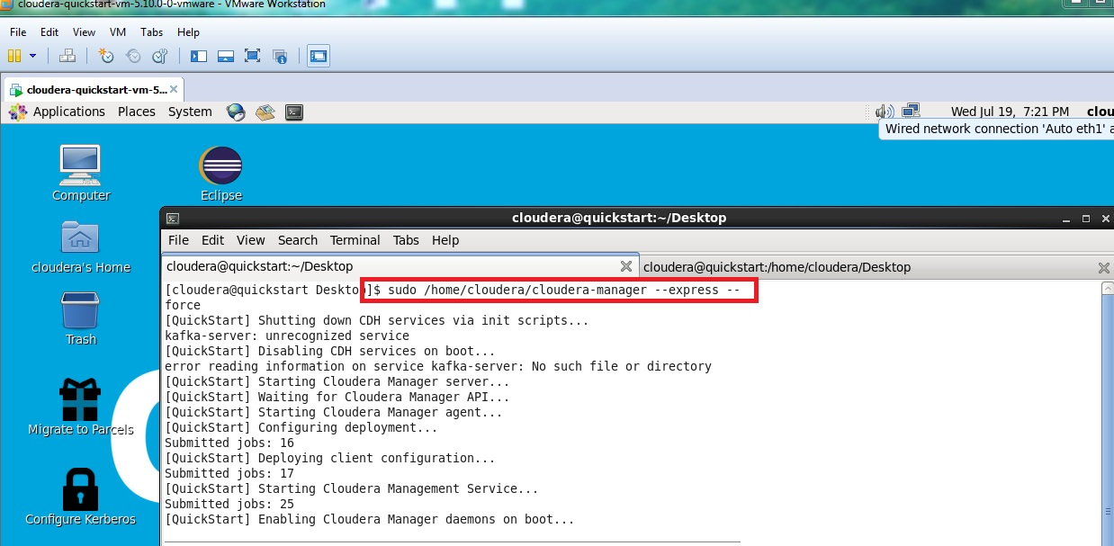
Installation, executing, grunt shell.
Vijaya Raja Mayuri Akula

Slide 11
Pig Latin Data Model
Data Model Types:
Atom
Tuple
Bag
Map
Vijaya Raja Mayuri Akula

Slide 12
Pig operators
LOAD: Load data from the local file systems or HDFS storage into pig
ORDER BY: Order By is used to sort a relation in ascending or descending order using ASC and DESC keywords.
Vijaya Raja Mayuri Akula

Slide 13
Pig operators
FOREACH:
Use FOREACH-GENERATE operation to work with columns of data.
JOIN:
JOIN operator is used to perform an inner, equijoin join of two or more relations based on common field values.
Vijaya Raja Mayuri Akula

Slide 14
Pig operators
DUMP
Dumps or displays results to screen..
LOAD 'student' AS (name:chararray, age:int, gpa:float); DUMP A;
GROUP BY: The GROUP operator is used to group the data in one or more relations
grunt> group_data = GROUP Employee_details by age;
Vijaya Raja Mayuri Akula

Slide 15


Slide 16
REFERENCES
https://www.tutorialspoint.com/apache_pig/
https://www.youtube.com/watch?v=GG-VRm6XnNk

Slide 17


Slide 18


